Slide 1
Operating System Basic
Recap

Slide 2
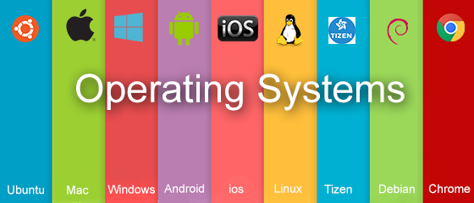

OS Basics

Slide 3
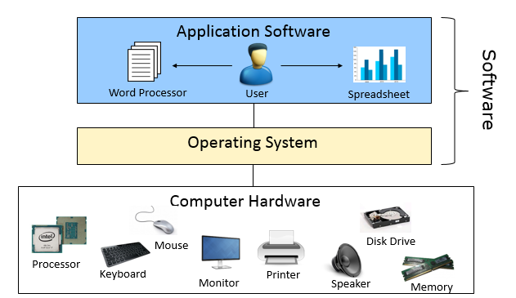
What is an Operating System?
An operating system (OS) is a collection of software that manages computer hardware resources and provides common services for application software.

Slide 4

Functions of Operating System
Operating system performs many functions. Basically, operating system performs:
File Management
Process Management
Memory Management
Device Management
Users
Operating
System
User Interface
File
Management
Process
Management
Memory
Management
Device
Management
Hardware
Storage
Devices
CPU
Main
Memory
I/O
Devices
Notes:
I/O – Input/Output

Slide 5
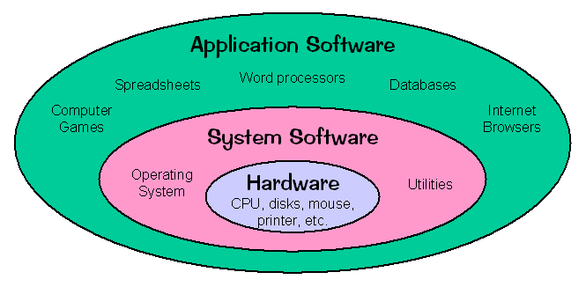
Computer Software
Computer software is a series of related instructions that tells computer what tasks to perform and how to perform them.
The two categories of software are system software and application software.

Slide 6
Computer Software – cont.
System software
Consists of the programs that control or maintain the operations of computer.
Operating system – a set of programs that coordinates all the activities among computer hardware
Utility program – most OS include utility programs for managing disk drives, printers, and other devices
Application software
Programs designed to make users more productive or assist them with personal tasks.
Examples: web browser, spreadsheet software, database software, etc.

Slide 7
Desktop vs Server Operating Systems
Desktop Operating System
Installed on a personal computer (PC) that is used by one person at a time, may or may not be connected to network
E.g. Windows 7/8/10, Mac OS
Server Operating System
Usually installed on a more powerful computer that is connected to a network, and can act in many roles to enable multiple users to access information, such as email, files and software.
Windows Server 2012/2016

Slide 8
Open Source vs Proprietary Operating Systems
Open source OSs are based on open, published source code that can be modified and improved by anyone.
E.g. Ubuntu and Fedora OS (Linux OS)
For Proprietary OSs, the source codes are accessible only by the company that produced that OS, such as Apple and Microsoft.
E.g. Microsoft Windows and Apple’s Mac OS

Slide 9




Current Operating Systems
Most common OSs fall into the several families:
Windows 7, 8, and 10
Windows Server 2008, 2012, 2016
Different distributions of UNIX/Linux OSs, such as Fedora, Ubuntu.
Apple Macintosh Mac OS X (versions 10.13 High Sierra-2017 and version 10.14 Mojave-2018)

